Slide 1

ABC Call Volume Trend Analysis
Saroj Kumar Mahto

Slide 2
Project Description
A Customer Experience (CX) team plays a crucial role in a company. They analyze customer feedback and data, derive insights from it, and share these insights with the rest of the organization. This team is responsible for a wide range of tasks, including managing customer experience programs, handling internal communications, mapping customer journeys, and managing customer data, among others.
In the current era, several AI-powered tools are being used to enhance customer experience. These include Interactive Voice Response (IVR), Robotic Process Automation (RPA), Predictive Analytics, and Intelligent Routing.
One of the key roles in a CX team is that of the customer service representative, also known as a call center agent. These agents handle various types of support, including email, inbound, outbound, and social media support.

Slide 3
Approach
Importing and understand-ing the data
Perform the various analysis to derive insights
Making the report and explaining the project
Cleaning the dataset as per the requirement.
Visualizing the outputs in charts and graphs

Slide 4




Tech Stack Used
MS EXCEL
MS POWERPOINT
Python & jupyter notebook
OBS STUDIO

Slide 5
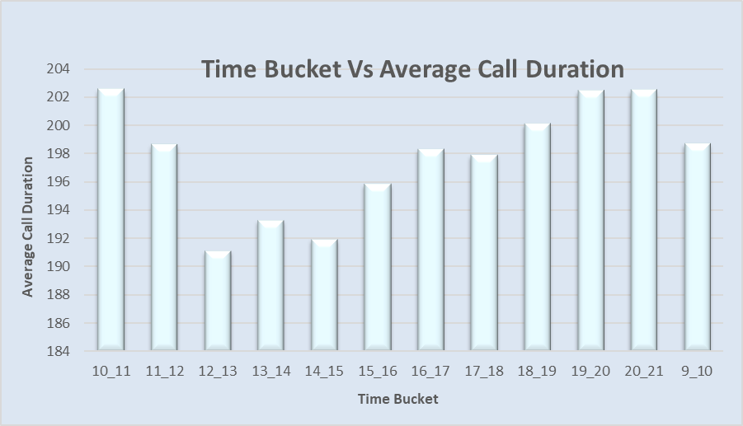
Task 1: Average Call Duration

Slide 6
Task 1: Average Call Duration
In the morning 10 am – 11 am and evening 20 pm -21 pm we can see high call duration.
The number is lesser in the daytime during 12 to 3 pm.

Slide 7
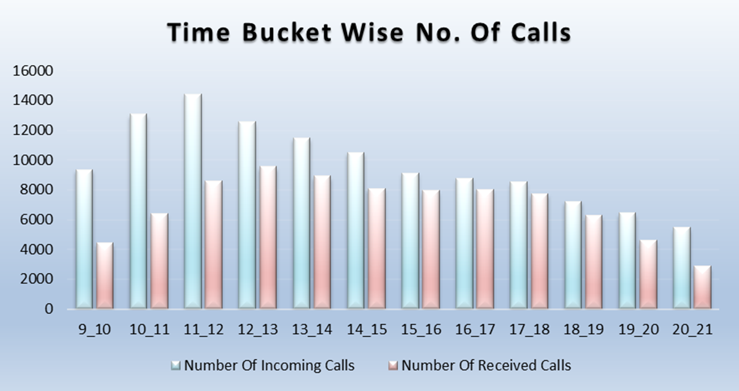
Task 2: Received Calls

Slide 8
Task 2: Received Calls
The time bucket 11 am – 12 pm has the highest number of calls followed by 10 –11 am and 12 – 13 pm.
The highest number of received calls is in the time bucket of 12 – 13 followed by 13 – 14 and 11 – 12.

Slide 9
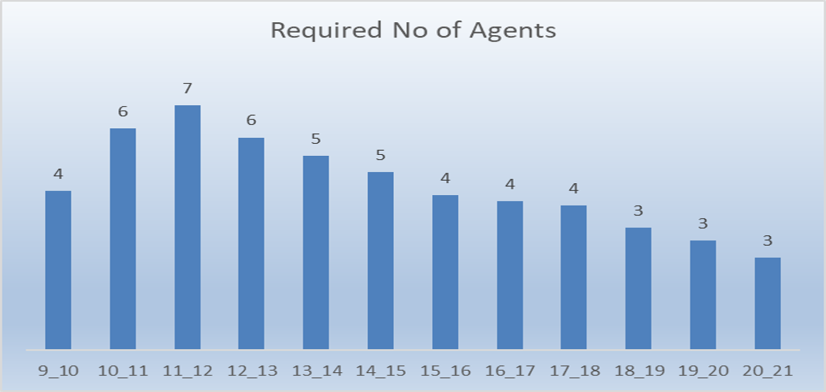
Task 3: Manpower Planning

Slide 10
Task 3: Manpower Planning
The highest no of agents is required in the time bucket of 11 -12 followed by 10 –11 am and 12 – 13 pm.
The least number of agents are required in the evening during
6 –9 pm.

Slide 11
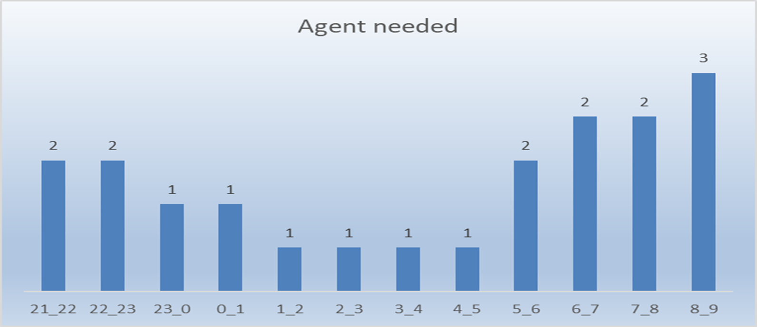
Task 4: Night Shift Manpower Planning

Slide 12
Task 4: Night Shift Manpower Planning
The highest no of agents is required in the time bucket of 8-9 am..
The least no is required in the night between 12 to 5 am.

Slide 13

Thank you
Link:
https://drive.google.com/drive/folders/10BcA6_L1VWqSqkRQadqzDh1ju_GQBvrj?usp=sharing

